Slide 1


Grade 10/11/12 Course Selection 2025-2026 Planning for Graduation

Slide 2
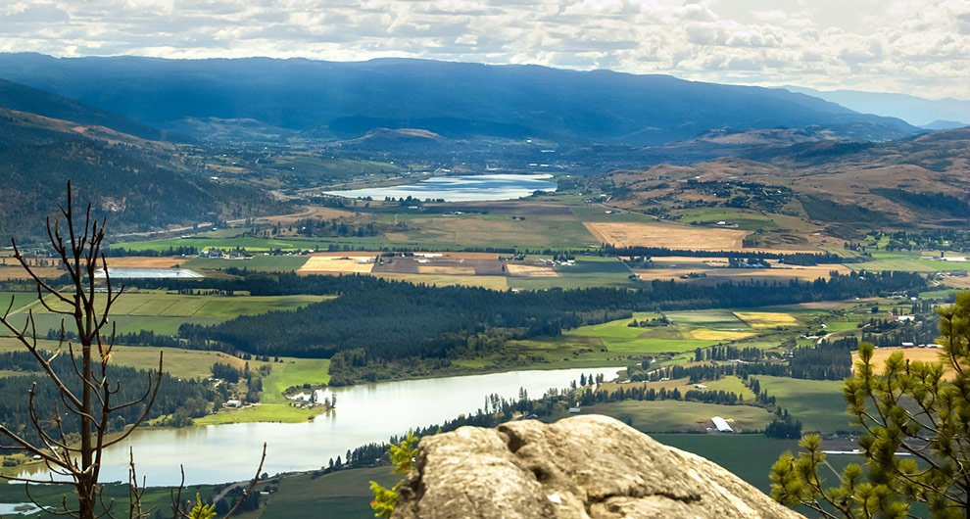
Welcome to the traditional unceded lands of the Secwepemc and Sylix people

Slide 3

What Is the Grad Program?
CLASS OF
2026
2027
2028
Covers grades 10-12
Courses are now worth credits
Credits are the currency with which you graduate
You need enough of the right credits to graduate
3 Provincial Assessments

Slide 4
Graduation Ceremony
Starting for Grad 2026 – Students will need to be in a position to graduate by the end of the school year to participate in the convocation ceremony (you can still participate in Prom)
What does this mean? If you need to return to PVSS in the fall to complete a few more courses to graduate, you will not be able to participate in the convocation ceremony.
Exceptions: If you need to complete Work Experience or a Career Program over the summer. You will be able to participate.
When will I know if I can Participate: Final decisions will be made in Late May for students in danger of not graduating.

Slide 5

How to Plan
Your planning should be a combination of:
What courses do I need to graduate?
What courses do I need to pursue my career goals?

Slide 6
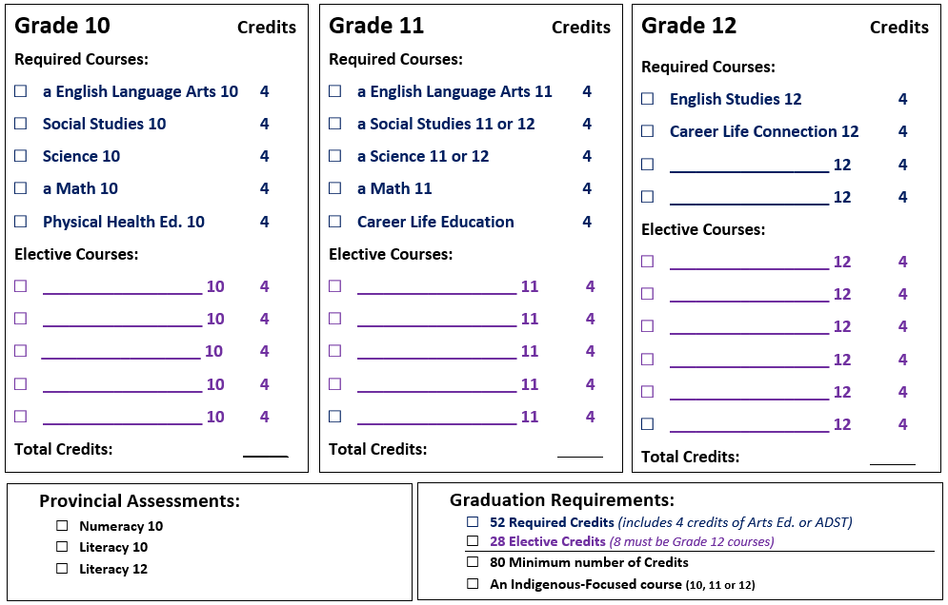
Course Planning

Slide 7
Indigenous Grad Requirement
Students must take at least one Indigenous focused class in grade 10, 11, or 12
English First Peoples 10
English First Peoples 12
BC First Peoples 12
Contemporary Indigenous Studies 12

Slide 8
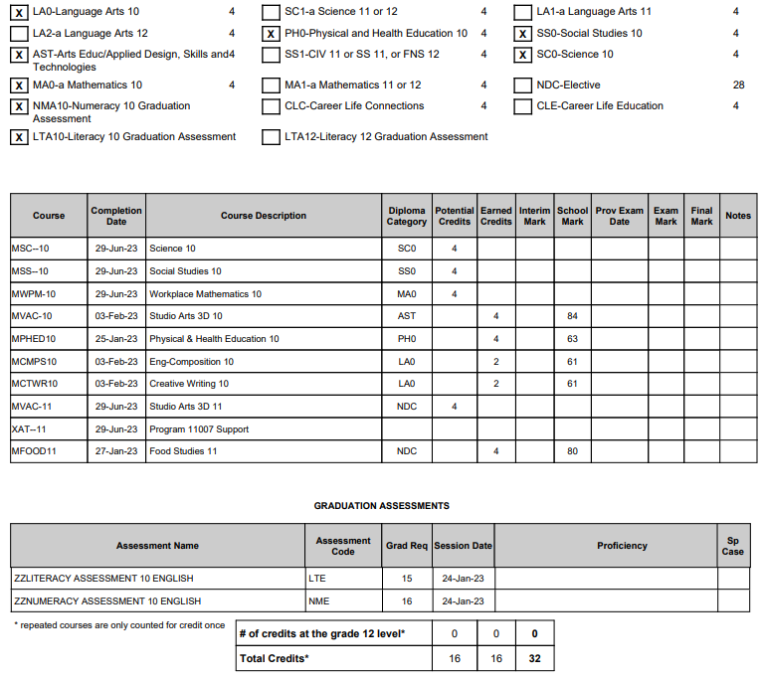
Diploma Verification

Slide 9
English Options
Grade 10
English 10
English First Peoples 10
Grade 11
Literary Studies 11
Grade 12
English 12
English First Peoples 12

Slide 10
Social Studies Options
Grade 10
Social Studies 10
Grade 11/12
20th Century World History 12
Law Studies 12
BC First Peoples 12
Contemporary Indigenous Studies 12

Slide 11
Science Options
Grade 10
Science 10
Grade 11
Chemistry 11
Life Science 11
Physics 11
Environmental Science 11
Horticulture 11
Grade 12
Chemistry 12
Life Science 12
Physics 12

Slide 12
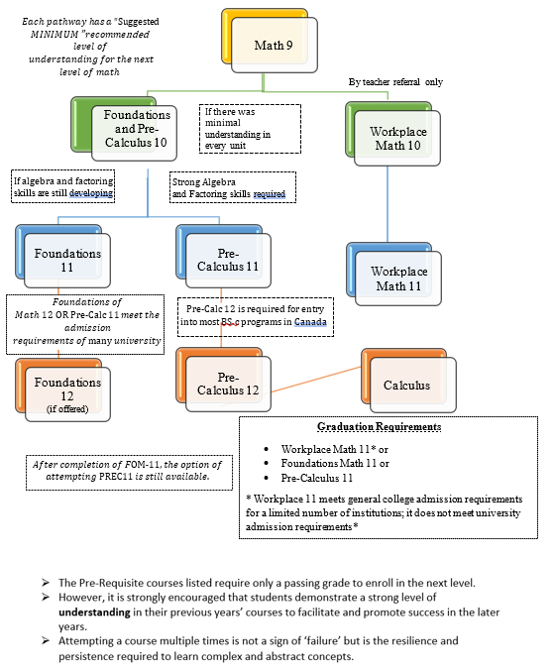
Math Options
All students must have a grade 10 math and a grade 11 math to graduate.

Slide 13
Physical and Health Education (PHE)
Grade 10 (required)
PHE 10
Active for Life 10
Dance Conditioning 10
Grade 11/12 (not required)
Active Living 11/12
AM Fitness (OTT)
Athletic Leadership 11/12

Slide 14
Physical and Health Education (PHE)
Active for Life 10
Focus is individual and collective well-being and lifestyle activities that promote physical, social, mental, and emotional well-being as well as active living.
Activities can range from fitness activities such as hiking (all season), walking, yoga, minor games, and circuit training.
Develop strategies on self-care, goal setting, conflict resolution, self-awareness (and identity), inclusion, nutrition, and mental wellness.
Dance Conditioning 10 (10/11/12)
Same format as a dance class including warm up, exercise, and ending with a cool down.
Physical activities designed to maintain or enhance your overall fitness and improve your dance technique.
Students will also develop a positive sense of physical and emotional well-being as well as mindfulness.

Slide 15
Hockey Academy
This program of choice is offered to any students in Grades 9-12, and involves enrolling in two courses (PHE and Hockey Academy).
Please be aware that there is a cost of roughly $450 per student. Students may select this program when completing course selection and then contact the school to arrange payment.
The program is offered inside the regular school day and within the school timetable and will include at least two sessions a week on ice at Sunbelt Arena, as well as tactical training, fitness, nutrition, leadership, and mentorship components that will occur off ice during the school day.
Grade | Hockey Related Course | Physical Education Related Course
9 | Intro to Fitness 10 (YHRA-10C) | Physical and Health Education 9 (MPHE-09)
10 | Hockey Academy 10 (YHRA-10A) | Physical and Health Education 10 (MPHED10)
11 | Hockey Academy 11 (YHRA-11A) | Fitness and Conditioning 11 (MFTCD11)
12 | Hockey Academy 12 (YHRA-12A) | Fitness and Conditioning 12 M(FTCD12)

Slide 16
Career Education
Grade 10 – Not required
Grade 11 – Career Life Education 10
Grade 12 – Career Life Connections 12
Work Experience
Do you have a part/full time job? If so, talk to the Career Centre at your school about getting Work Experience 12A (and 12B) credit.

Slide 17
Youth TRAIN in Trades
At School Sites
Auto Body and Collision Technician (Level 1)
February 2025, next intake at A.L. Fortune
Professional Cook 1 (PC1)
February 2025, next intake at A.L. Fortune
Hairstyling
February 2025, next intake at PVSS
At Okanagan College
Carpenter Foundations (Okanagan College)
January 2025 (Salmon Arm)
Electrical Foundations (Okanagan College)
February 2025 (Vernon)
Plumbing Foundations (Okanagan College)
July 2024 (Vernon)
Welding Foundations (Okanagan College)
February 2025 (Salmon Arm)
See Mr. Brown For More Information

Slide 18
More Ways to Grad!
Academic Programs
Emergency Medical Responder 12 (PVSS-Feb 2026)
This course will be offered as a block inside the timetable semester 2 at PVSS.
This course will build a solid foundation for individuals entering the healthcare field and well-suited for those interested in employment with ambulance services, fire departments, industrial projects, recreational facilities and more.
See Mr. Brown For More Information

Slide 19
More Ways to Grad!
Academic Programs
Office Assistant Certificate (OC)
Health Care Assistant Certificate (OC)
Administrative Assistant Certificate (OC)
Early Childhood Education Certificate (OC)
Education Assistant Certificate (OC)
Medical Office Assistant (OC)
Medical Device Reprocessing Equipment Certificate (OC)
Unit Assistant Certificate (OC)
Gateway to Technology Workplace Certificate (OC)
Information Technology User Support Micro-Credential (OC)
Medical Lab Assistant Certificate (TRU)
Emergency Medical Responder (PVSS-Feb 2026)
Youth WORK in Trades
Students that work with a qualified tradesperson (i.e. licensed mechanic, electrician, butcher….) can sign up as a WORK student and receive 16 high school credits if you acquire 480 hours of paid work
4th Class Power Engineering
Partnered with British Columbia Institute of Technology – BCIT
See Mr. Brown For More Information

Slide 20
Elective Classes
ADST & Arts & PHE
Grade 10
Computer Studies 10
Engineering 10
Food Studies 10
Mechanical Trades 10
Woodwork 10
Dance 10
Drama 10
Theatre Production 10
Musical Theatre 10
Concert Band 10
Choir/Guitars 10
Studio Arts 2D 10
Studio Arts 3D 10
Grade 11/12
Child Development and Caregiving 12
Food Studies 11/12
Baking 12
Sr. Trades 11
Automotive Technology 11 /12
Auto Engine & Drivetrain 12
Metalwork 11/12
Woodwork 11/12
Woodwork 12: Furniture and Cabinets
Dance 11/12
Dance Conditioning 11/12
Theatre Production 11/12
Musical Theatre 11/12
Concert Band 11/12
Choir/Guitars 11/12
Studio Arts 2D 11/12
Studio Arts 3D 11/12
Active Living 11/12

Slide 21
Academic Elective Classes
Grade 10
French 10
Grade 11/12
French 11/12
Literary Studies 12
Psychology 12
Pre-Calculus 12
Calculus 12
Statistics 12
20th Century World History 12
Law Studies 12
BC First Peoples 12
Contemporary Indigenous Studies 12
Chemistry 11/12
Life Sciences 11/12
Physics 11/12
Environmental Science 11
Horticulture 11

Slide 22
Elective Classes
Out Of The Timetable (OTT)
Grade 10
Jazz Band 10
Blues Band 10
Leadership 10 (application)
AM Fitness 10
Yearbook 10
Peer Mentoring 10 (application)
Grade 11/12
Adrenaline Dance Company 11/12 (application)
Jazz Band 11/12
Blues Band 11/12
Leadership 11/12 (application)
AM Fitness 11/12
Athletic Leadership 11/12 (application)
Yearbook 11/12
Peer Mentoring 11/12 (application)
Work Experience 12A/12B

Slide 23
New Courses – Inside the Timetable
Choir and Guitars 9-12
Choir and Guitars is a course for those who like to sing and perform in a group setting. The purpose of this course is for singers and beginner guitarists to explore many genres and realms of music.
Child Development and Caregiving 12
Discover the challenges and joys of child development and caregiving in this grade 12 course. While the primary focus of the course is the social, physical, and emotional development of a child from birth to age 12, students will also explore the health and experience of caregivers and their families in a variety of cultures. If you see a future in parenthood, education, childcare, healthcare, or social work, this course is for you.

Slide 24
New Courses (OTT)
AM Fitness and Conditioning 10/11/12
Before school in semester 2.
This is a physically demanding course and is developed for students who are serious about improving their overall fitness and willing to challenge themselves physically. This course can also be personalized for high-level athletes with performance-based goals.
Offer students the skills, knowledge, and attitude to incorporate strength training, agility, plyometrics, flexibility and cardiovascular fitness into their personal training regime and lifestyle.
Athletic Leadership 11/12
Students will be involved with planning, organizing, promoting, and operating school sporting events and activities throughout the school year.
Course activities include the PVSS intramurals program, managing and promoting school sports teams, assisting with home games and score table duties.
Athletic Leadership 11 / 12 is for students who love to be involved with organizing school sports.

Slide 25
New Courses (OTT)
Yearbook 10/11/12
Students will produce our school yearbook and enjoy learning about digital and standard photography, page layout and design, computer photo manipulation, and desktop publishing. Students will also sharpen their communication skills, develop their organizational talents.
Peer Mentoring 10/11/12
Work with diverse learners and/or younger peers. The course provides guidance in effective strategies for supporting other students in curricular areas through promoting a sense of inclusion and belonging and demonstrate the possibility wellbeing and academic success
Application required form from PVSS administration.

Slide 26
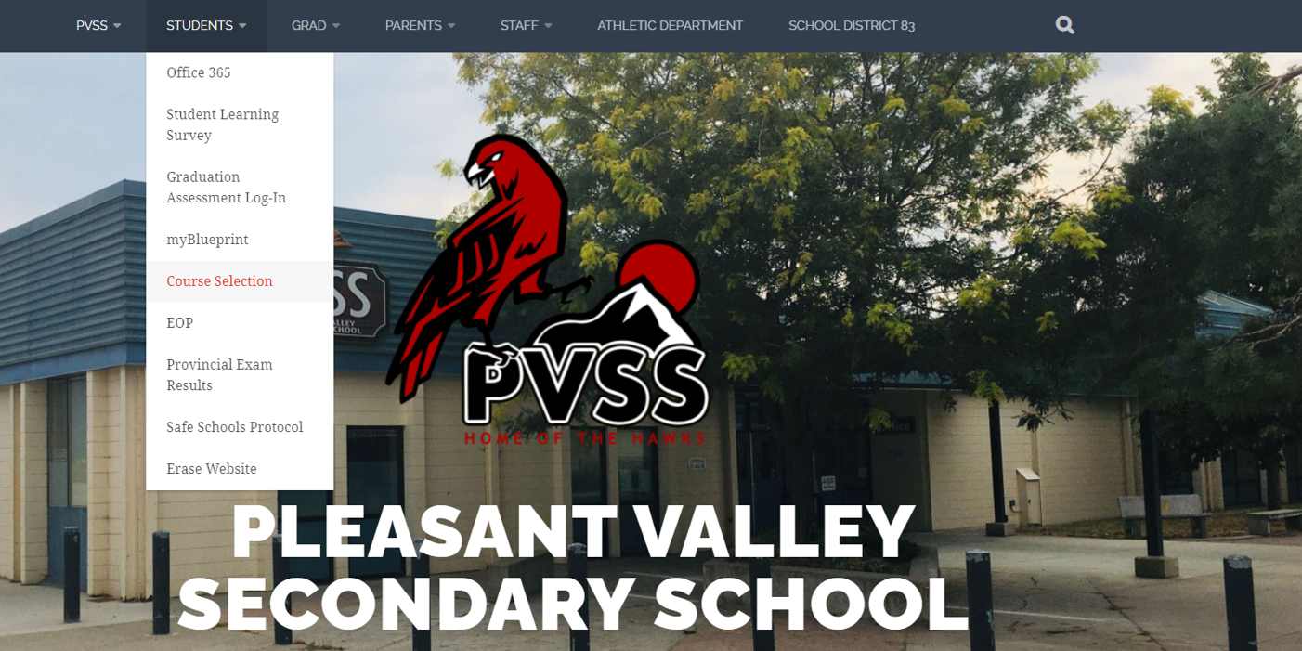
Course Selection
Course Selections will be completed online through My Blueprint (like last year)
Classes will be called to the computer lab next week
Please think about the courses you will select
Find more info in our Course Selection booklet on the school Website

Slide 27
Graduation!
Fundraising for Grad 2026 will start later this spring
There will also be a few opportunities this summer
Grad fees for 2025 are $200
Pay it forward at Grad 2025
Some university applications due in Late 2025
Local Scholarships in March 2026
CLASS OF
2026

