Slide 1


Welcome to PVSS!
Grade 9
Course Selection
2025-2026

Slide 2

Welcome to the traditional unceded lands of the Secwepemc and Sylix people

Slide 3

A Comparison
Middle School
High School
CORE teacher(s)
Explorations teacher(s)
50-minute classes
Linear classes
Academic teachers
Elective teachers
80-minute classes
Semester-based classes
(few linear classes)
Responsibility…
Accountability…
Expectations…
Transitioning from
Adult Monitored…
to Student Managed

Slide 4


Student Support Services
  PVSS Is An Inclusive Space
  We Are Here To Help If You Need
  Counselling
    Learning Resource Centre
  Indigenous Support Workers
  Certified Education Assistants

Slide 5
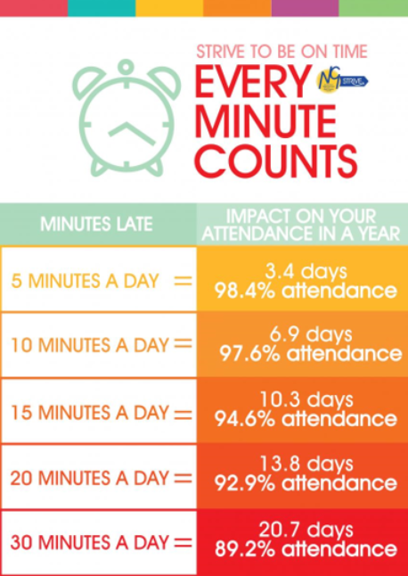
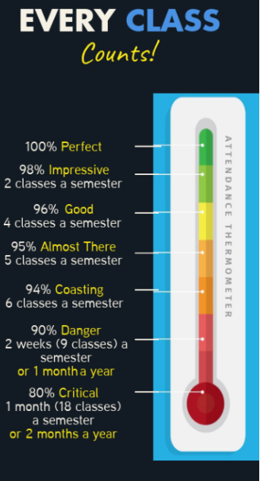

Slide 6
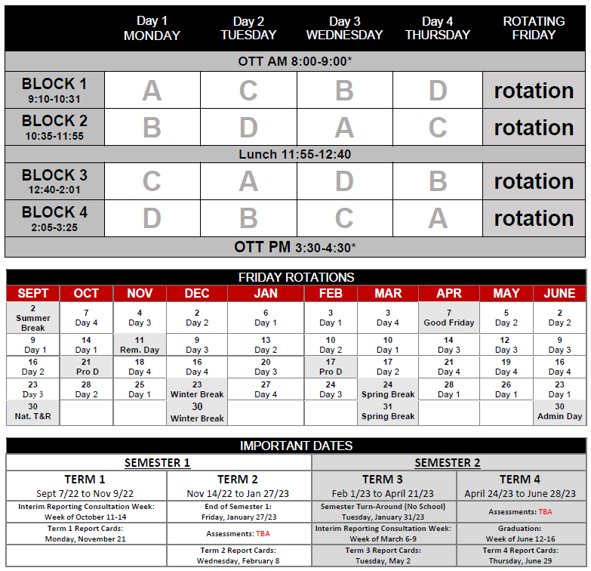
Sample
Student Schedule:
Science
French
Math
PHE
Math
PHE
Science
French
French
Math
Semester 1: September-January
  A → Science 9
  B → Math 9
  C → French 9
  D → PHE 9
Semester 2: February-June
  A → English 9
  B → Foods 9
  C → SS 9
  D → Computers 9
Science
PHE
PHE
Math
French
Science

Slide 7
Grade 9 Classes
1. English 9
2. Social Studies 9
3. Science 9
4. Math 9
5. PHE 9 or AFL 9
6. Elective #1
7. Elective #2
8. Elective #3
REQUIRED
All grade 9 students take these courses.
CHOICES
Different for every student.

Slide 8

English 9
The major goal of English 9 is to provide learning strategies around the three core competencies of thinking, communicating and personal / social learning. This will be done by examining a variety of texts and genres. Students will learn literary techniques and explore creative writing, poetry, and other writing processes.

Slide 9
Social Studies 9
Topics include: Confederation, development of the Canadian West, Canada’s physical geography, Canada’s economic activities and relationship with other countries, and revolutions. Current events will also be a focus of this course.

Slide 10
Math 9
All students must enroll in Math 9. Concepts include operations with rational numbers, exponents, polynomials, linear relations, linear equations, proportional reasoning, statistics in society and financial literacy.

Slide 11
Science 9
Science 9 exposes students to a wide variety of ideas and theories in various fields, much of which is designed to provide a general background for future Science studies. Emphasis is placed on the practical applications of Science principles. The major topics include: Biology (Genetics and Reproduction), Chemistry (Symbols, Formulas, and Chemical Reactions), Electricity and grand cycles of matter and energy.

Slide 12
Physical and Health Education 9
Physical and Health Education 9
Participation-based course focusing on well-being and the connections between physical, intellectual, mental, and social health. Students experience a variety of individual, dual and team activities. Students will gain the knowledge, movement skills, positive attitudes and behaviours that contribute to lifelong physical health and mental well-being. Students are required to wear appropriate PHE strip which includes a clean T-shirt, clean shorts and proper indoor shoes. PVSS PHE strip is available for purchase if students require a T-shirt or shorts.
OR
Active for Life 9
The focus of this course is individual and collective well-being and lifestyle activities that promote physical, social, mental, and emotional well-being as well as active living. Class activities will be co-created with students based on their choices and preferences. Activities can range from fitness activities such as hiking (all season), walking, yoga, minor games, and circuit training, to mind-body connection activities such as breathing, balancing, and concentration exercises. This class will also include ways to develop strategies on self-care, goal setting, conflict resolution, self-awareness (and identity), inclusion, nutrition, and mental wellness.

Slide 13

Electives
In Grade 9, you have five required courses and three elective (choice) courses.
It is important to select elective courses based on YOUR OWN personal interest.
Be open to trying new things!

Slide 14
French 9
French 9 is designed to provide opportunity and encouragement for students to build and master skills learned in French 8 and to continue to develop communication skills in reading, listening, speaking, and writing.
Some university degree programs require a language 11 as an entrance requirement.

Slide 15
Computer Explorations 9 (ADST)
Want to learn what a computer is all about? This course focuses on using the computer as a tool in order to help students become more efficient and productive. The course will include lessons and projects used to develop the understanding of Microsoft Office: Word, Excel, and PowerPoint. The course will also help with research techniques and strategies while using the internet (such as using Google effectively). Students will be introduced to Video Game design and experiment with creating digital images. A good portion of this course is dedicated to projects so come ready to learn, create, and share.

Slide 16
Foods 9 (ADST)
In this course, you will have a chance to learn culinary essentials and have fun creating dishes that are healthy and delicious…giving you the skills to survive on your own! You will develop the foundational skills and knowledge to prepare food from “scratch” and confidently make healthy and positive choices involving food. Recipes during the semester will include baking, desserts, lunches, soups, snacks, breakfasts etc.! It is hoped that students will leave this course with an appreciation of simple food preparation and how integral it is to our lives.

Slide 17
Jr. Trades 9 (ADST)
Did you hear about the fun in Jr. Trades? Interested in learning valuable hands-on skills? This course explores practical skills from 4 modules based on construction trades: carpentry, plumbing, electrical, drafting. Each module is introduced with technical knowledge and has students creating labs/activities from basic design and engineering principles. Great for students who think they might be interested in pursuing a career in the construction trades or who want to be versatile and have a broad range of hands-on skills. This course is run in conjunction with ITA curriculum.

Slide 18
Mechanics and Metal 9 (ADST)
Want to learn about how to repair mechanical things and build stuff from metal? This is an introductory course into understanding and repairing engines along with projects that give a taste of welding and fabricating with metal. The core mechanical work is tear-down and reassembly of small engines. Be a whiz with a lawnmower or dirt bike. Several small projects are constructed from metal including candleholders, pencil holders and small motors.

Slide 19
Woodwork 9 (ADST)
Are you ready for the big time? Woodworking in a full woodshop? This course is for students new to woodwork that are ready to step up to tools and processes used in grade 9 woodworking. It will include both traditional and innovative woodworking techniques using the latest CNC technology. Students will learn the safe operation of power equipment and produce practical and decorative projects. Students will add their own design input to Instructor guided projects. Projects will include CNC Laser (computer designed) engraving projects. Projects in the past have included step-stools, bookshelves, name plaques, phone speakers and wooden toys.

Slide 20
Dance 9 (Arts)
Dance 9 is a physically demanding, activity-based courses that emphasize individual growth of skills while prioritizing a teamwork environment. Come learn a fun new skill or refine your skills, while improving your fitness and flexibility levels while dancing to fun music with your friends! Dance 9 includes four main components:
Technical skills and choreography training in jazz, hip hop, musical theatre, tap, modern/contemporary, lyrical, and partner dance genres
Cardio, strength, and flexibility training
Dance composition (how to choreograph) based on the fundamental elements of dance
Final public performance in the semester-end dance gala show – mandatory!

Slide 21
Drama 9 (Arts)
Drama provides students with opportunities to explore human experiences through character and situations. All drama students are required to actively participate, collaborate with others, and demonstrate personal commitment. Drama is a fun and creative way to express ideas, emotions, stories, and characterizations through games, improvisation, skits, monologues, plays, performances, and skill and team building exercises.

Slide 22
Concert Band 9 (Arts)
This course is for any Grade 8 students interested in learning an instrument and being part of a band. There will be emphasis on technical development, tuning and intonation, and balance. Students will work on performance skills as a team. Students who missed band in Grade 8 are welcome to sign up for this course. The more the merrier!

Slide 23
Choir/Guitars 9 (Arts)
Choir and Guitars is a course for those who like to sing and perform in a group setting. The purpose of this course is for singers and beginner guitarists to explore many genres and realms of music. Groups will perform at occasions and venues appropriate to their level. There will be opportunities to sing and/or play guitar in small or larger groups. This course will explore music that is both old and new with student input. There is no prerequisite for this course.

Slide 24
Visual Art 9 (Arts)
Visual Art 9 introduces grade 9 students to both two-dimensional and three-dimensional art forms. Students will explore drawing, painting, ceramics, sculpture, printmaking, and mixed media in an active, “hands on” environment. This course will provide a solid foundation in visual arts and will prepare grade 9 students for Studio Arts 2D 10 or Studio Arts 3D 10.

Slide 25
Hockey Academy
This program of choice is offered to any students in Grades 9-12, and involves enrolling in two courses (PHE-09 and Hockey Academy 9).
Please be aware that there is a cost of roughly $450 per student. Students may select this program when completing course selection and then contact the school to arrange payment.
The program is offered inside the regular school day and within the school timetable and will include at least two sessions a week on ice at Sunbelt Arena, as well as tactical training, fitness, nutrition, leadership, and mentorship components that will occur off ice during the school day.

Slide 26
Outside the timetable classes (OTT)
Some courses at PVSS are offered outside the regular timetable. This could be in the morning before school starts or after school.
Students may select OTT classes as a 9th class and will be responsible to get to class without a bus.

Slide 27
Jr. Jazz Band (OTT)
With Big Band instrumentation, this limited enrollment class focuses on Jazz music. This group requires professionalism and diligent practice of its members. Jazz improvisation, ensemble refinement, and independent rehearsal skills are some of the major areas of focus.
Prerequisite: permission of the teacher for grade 9s

Slide 28
Blues Band 9-12 (OTT)
This course exists to provide guidance to and structure for a student-led musical group. Students will have regular rehearsals and be expected to prepare for, plan, book and perform at occasions and venues appropriate to their genre. The teacher will support these activities with guidance, instruction, facilities, and equipment as necessary. Most students taking this course will play in genres involving the key elements of Pop, Rock and Jazz.
Prerequisite: permission of the teacher

Slide 29
Timeline
TODAY – We are here to talk to you about course selection (take your information and forms home)
February 26 – Parent Meeting at PVSS at 6:00pm
(Students welcome too!)
MARCH 7 – Deadline for returning forms to school
JUNE – Timetables handed out
JUNE – Contact the school to request any changes (email)

Slide 30
Timetable Changes
All students must select three electives plus two alternates. Top choices are not guaranteed.
Timetable is being built based on student choices.
That means you determine how many sections of each class we put in the timetable.
Make sure you choose carefully, because timetable changes might not be possible after your schedule is built.
It’s not a race!

Slide 31
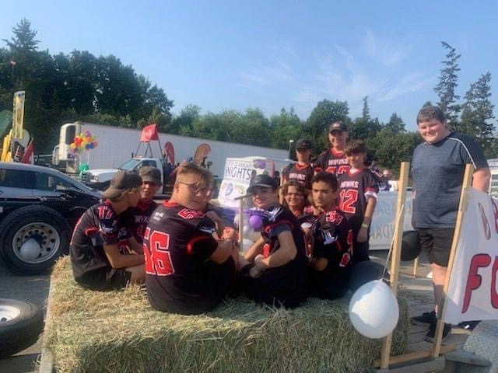
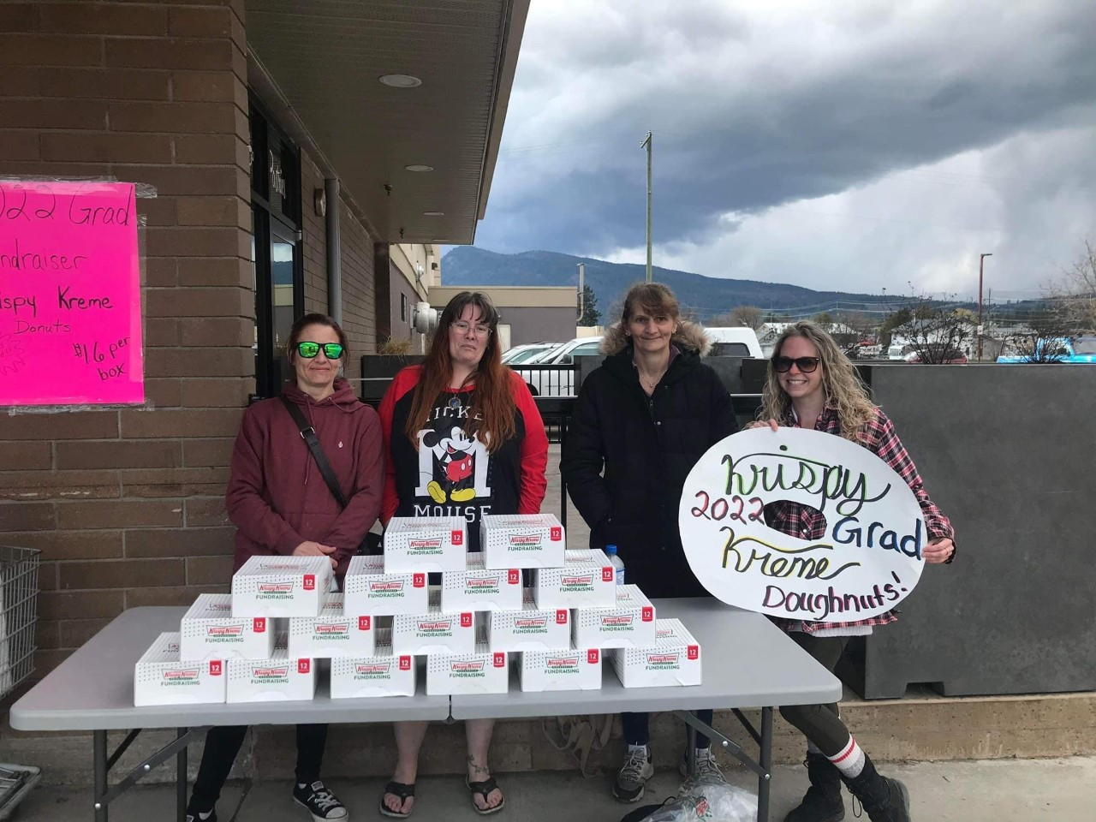
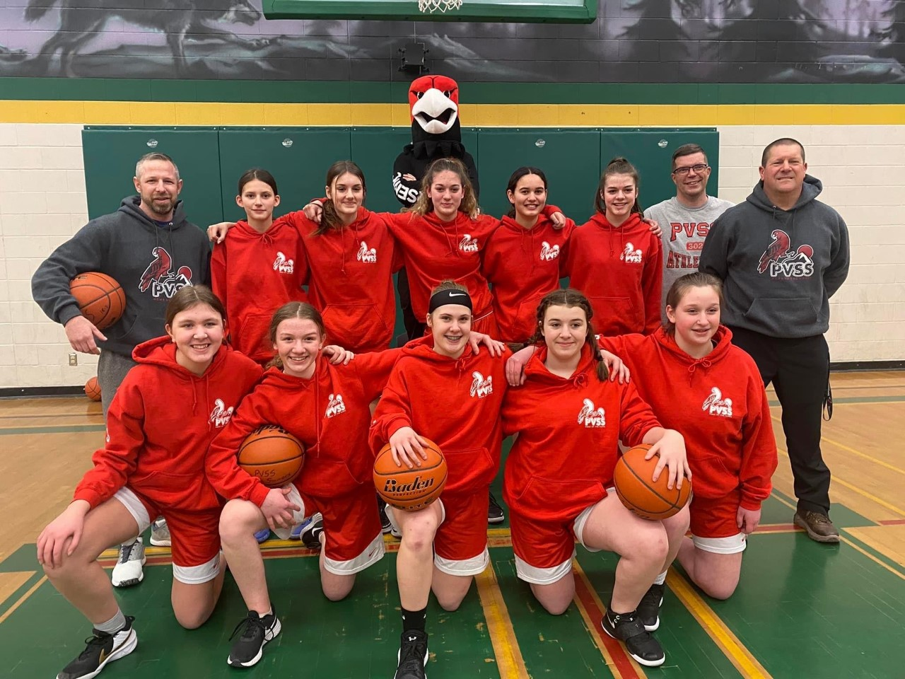
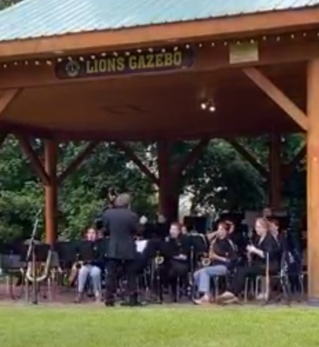
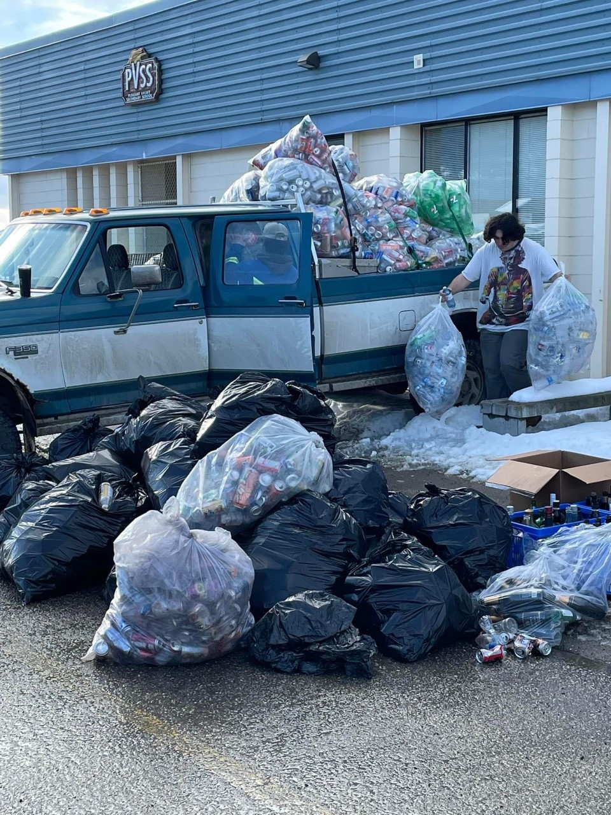
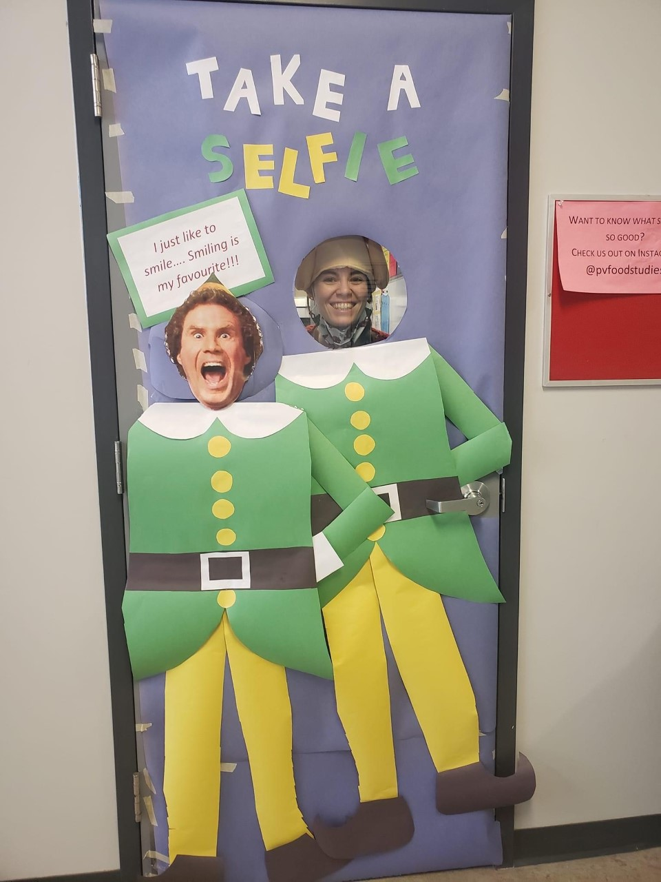

Get Involved!
Leadership
School Activities
Field Trips
Athletics

Slide 32
Get Involved!!!
At Lunch/
after school
GSA Club
Art Club
EV Club
Photography Club
Intramurals
Bring your ideas!
School Sports
Fall
Football
Cross country running
Boys Soccer
Volleyball
Winter
Basketball
Curling
Spring
Track and Field
Rugby
Girls Soccer
Golf
Tennis
Badminton

