Slide 1


Welcome to PVSS!
Grade 8
Parent Night
March 2025

Slide 2
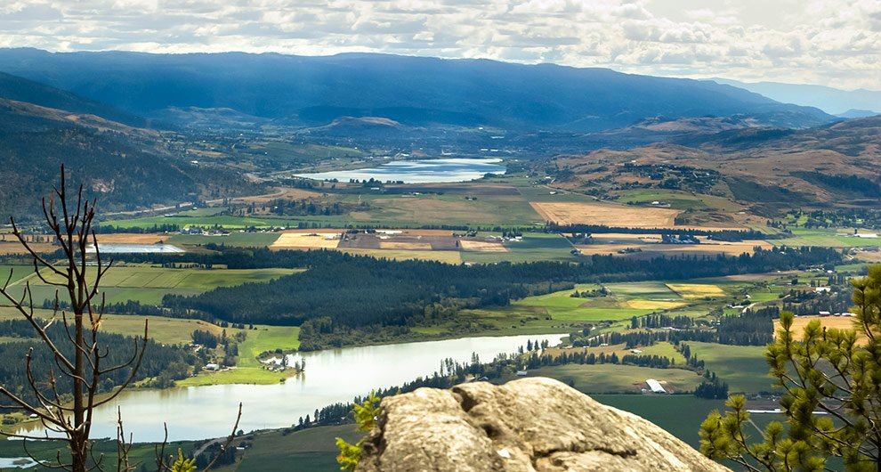
Welcome to the traditional unceded lands of the Secwepemc and Sylix people

Slide 3

A Commitment to Attend
The best way to support your student’s transition to high school is to get them here on a regular basis.
Regular attendance:
  Reduces student stress
  Increases achievement
  Decreases failure rates
Every absence – excused or unexcused – impacts student learning, mental health and overall achievement!
Please let our clerical team know
of expected absences.

Slide 4
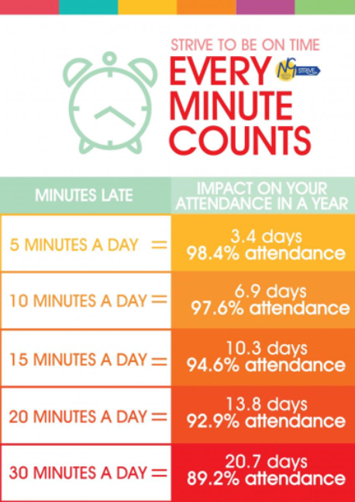
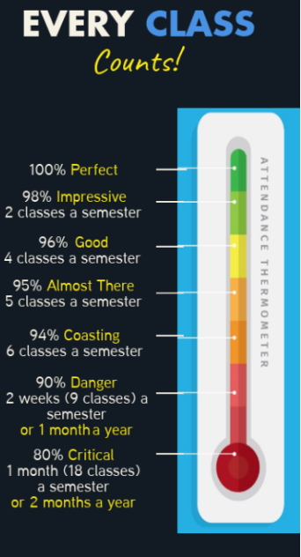

Slide 5
Student Progress
Stay connected!
Rough reporting timelines
October – Semester 1 interim report
November (3rd week) – Term 1 report (Semester 1 Midterms)
February (2nd week) – Term 2 report (Semester 1 Final grades)
March (1st week) – Semester 2 interim report
May (1st week) – Term 3 report (Semester 2 Midterms)
June (last day) – Term 4 report (Semester 2 Final Grades)

Slide 6





Code of Conduct
Available on our website, in full.
Some frequently asked highlights:
Cell phones (technology) are expected to be put away during instructional time
Students are expected to follow the direction of adults
Be kind
All students are entitled to a safe education
Students are expected to attend regularly, on time and remain in class … there is always something to do!

Slide 7

A Safe and Inclusive Place to Learn!
Your child will be supported in an inclusive setting by a collaborative team of:
compassionate,
hard working, and
mindful educators.

Slide 8
Counselling Centre
Confidential
Referrals can be made by student, parent, outside community agencies, teachers
Support students with personal challenges
Education and support with mental health challenges
Liaising with community agencies
Encouragement to set personal and life goals and obtain the skills necessary to achieve them
Scheduling and academic planning

Slide 9
Learning Resource
Re-teaching of difficult concepts
adaptation or modification of assignments
Support with organizing and editing written work
Remedial instruction and practice to develop basic skills
Reading/scribing for quizzes and tests
Support in developing self-regulation and management skills
Enrolling Learning Resource blocks or drop-in as needed
CEA's work as a closely connected team with the Learning Resource Teachers

Slide 10

Indigenous Education Department
Advocate for and support all students of Indigenous ancestry within a school of all learning abilities
Provide cultural enrichment and academic support to students of Indigenous ancestry
Provide check-ins with students of Indigenous ancestry to see how they are doing and refer to other members of the school-based team if necessary
Are available to Indigenous students at lunchtime

Slide 11
SPARK Program
SPARK is an in-school alternate type program for students in Grades 10-12 that offers students the flexibility to complete their course work when the regular classroom setting isn’t working. This may be for a variety of reasons and all student admittance is referred through School Based Team.

Slide 12

A Comparison
Middle School
High School
CORE teacher(s)
Explorations teacher(s)
50-minute classes
Linear classes
Academic teachers
Elective teachers
80-minute classes
Semester-based classes
(few linear classes)
Responsibility…
Accountability…
Expectations…
Transitioning from
Adult Monitored…
to Student Managed

Slide 13
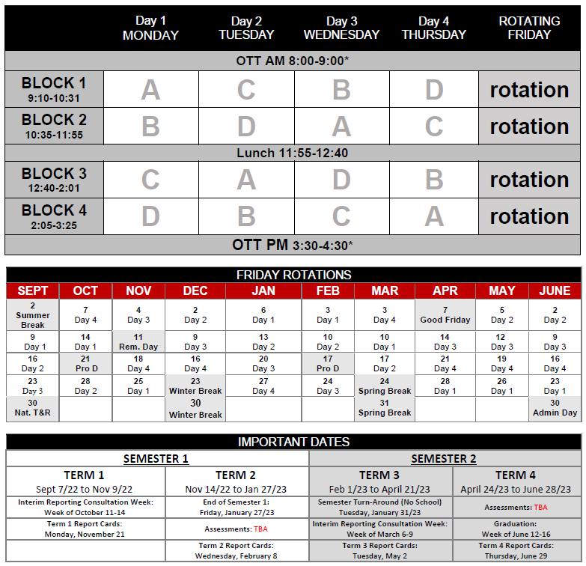
Sample
Student Schedule:
Science
French
Math
PHE
Math
PHE
Science
French
French
Math
Semester 1: September-January
  A → Science 9
  B → Math 9
  C → French 9
  D → PHE 9
Semester 2: February-June
  A → English 9
  B → Foods 9
  C → SS 9
  D → Computers 9
Science
PHE
PHE
Math
French
Science

Slide 14
Grade 9 Classes
1. English 9
2. Social Studies 9
3. Science 9
4. Math 9
5. PHE 9 or AFL 9
6. Elective #1
7. Elective #2
8. Elective #3
REQUIRED
All grade 9 students take these courses.
CHOICES
Different for every student.

Slide 15

Physical and Health Education 9
Physical and Health Education 9
Participation-based course focusing on well-being and the connections between physical, intellectual, mental, and social health. Students experience a variety of individual, dual and team activities. Students will gain the knowledge, movement skills, positive attitudes and behaviours that contribute to lifelong physical health and mental well-being. Students are required to wear appropriate PHE strip which includes a clean T-shirt, clean shorts and proper indoor shoes. PVSS PHE strip is available for purchase if students require a T-shirt or shorts.
OR
Active for Life 9
The focus of this course is individual and collective well-being and lifestyle activities that promote physical, social, mental, and emotional well-being as well as active living. Class activities will be co-created with students based on their choices and preferences. Activities can range from fitness activities such as hiking (all season), walking, yoga, minor games, and circuit training, to mind-body connection activities such as breathing, balancing, and concentration exercises. This class will also include ways to develop strategies on self-care, goal setting, conflict resolution, self-awareness (and identity), inclusion, nutrition, and mental wellness.

Slide 16

Electives
In Grade 9, Students have five required courses and three elective (choice) courses.
It is important to select elective courses based on personal interest.
Be open to trying new things!

Slide 17
French 9
French 9 is designed to provide opportunity and encouragement for students to build and master skills learned in French 8 and to continue to develop communication skills in reading, listening, speaking, and writing.
Some university degree programs require a language 11 as an entrance requirement.

Slide 18
Hockey Academy
This program of choice is offered to any students in Grades 9-12, and involves enrolling in two courses (PHE-09 and Hockey Academy 9).
Please be aware that there is a cost of roughly $450 per student. Students may select this program when completing course selection and then contact the school to arrange payment.
The program is offered inside the regular school day and within the school timetable and will include at least two sessions a week on ice at NorVal Arena, as well as tactical training, fitness, nutrition, leadership, and mentorship components that will occur off ice during the school day.

Slide 19
Outside the timetable classes (OTT)
Some courses at PVSS are offered outside the regular timetable. This could be in the morning before school starts or after school.
Students may select OTT classes as a 9th class and will be responsible to get to class without a bus.

Slide 20
Elective Classes
Inside the Timetable
Choir/Guitars 9
Computer Studies 9
Concert Band 9
Dance 9
Drama 9
Food Studies 9
French 9
Hockey Academy 9
Jr. Trades 9
Mechanics and Metal 9
Woodwork 9
Visual Art 9
Outside the Timetable (OTT)
Drumline 9
Jazz Band 9
Blues Band 9

Slide 21
Timetable Changes
All students must select three electives plus two alternates. Top choices are not guaranteed.
Timetable is being built based on student choices.
That means you determine how many sections of each class we put in the timetable.
Make sure you choose carefully, because timetable changes might not be possible after your schedule is built.
It’s not a race!

Slide 22

What’s after Grade 9?
BC Graduation Program
Covers grades 10-12
Courses are now worth credits
Credits are the currency with which you graduate
You need enough of the right credits to graduate
3 Provincial Assessments

Slide 23

How to Plan
Planning should be a combination of:
What courses are needed to graduate?
What courses are needed to pursue career goals?

Slide 24
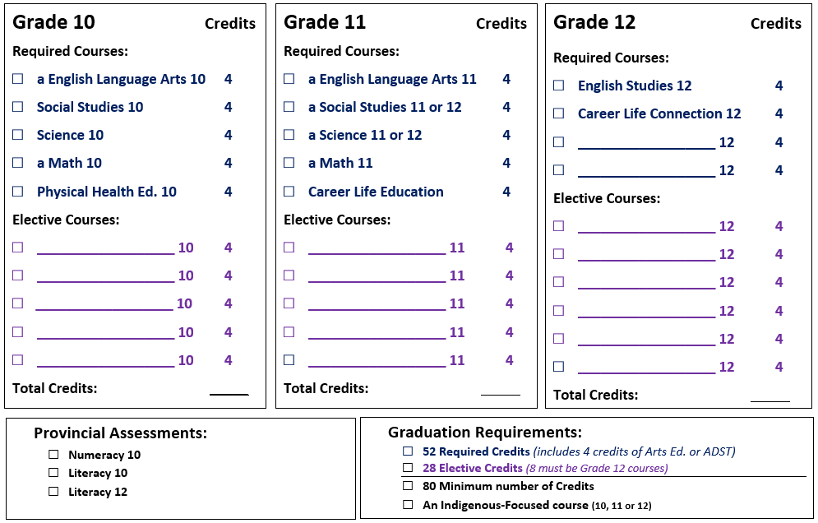
Course Planning

Slide 25
Indigenous Grad Requirement
Students must take at least one Indigenous focused class in grade 10, 11, or 12
English First Peoples 10
English First Peoples 12
BC First Peoples 12
Contemporary Indigenous Studies 12

Slide 26
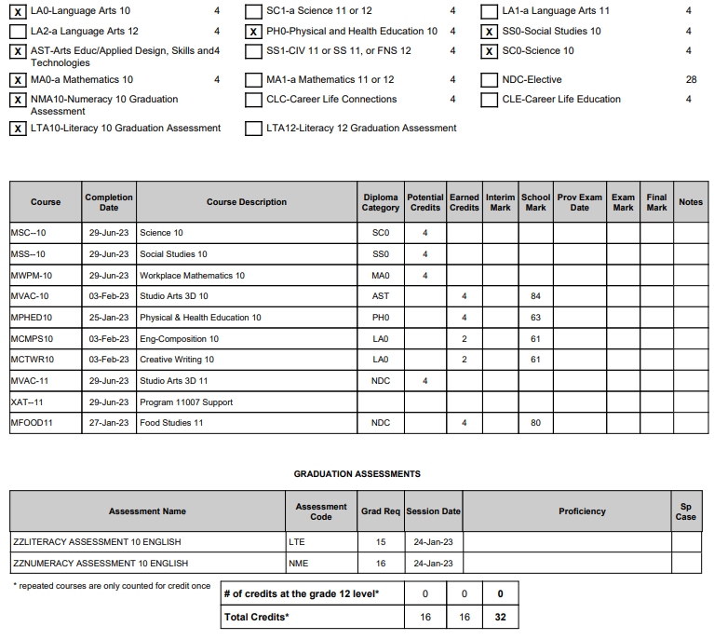
Diploma Verification

Slide 27
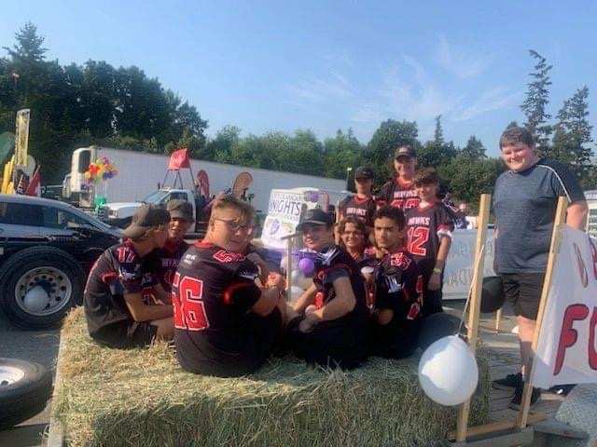
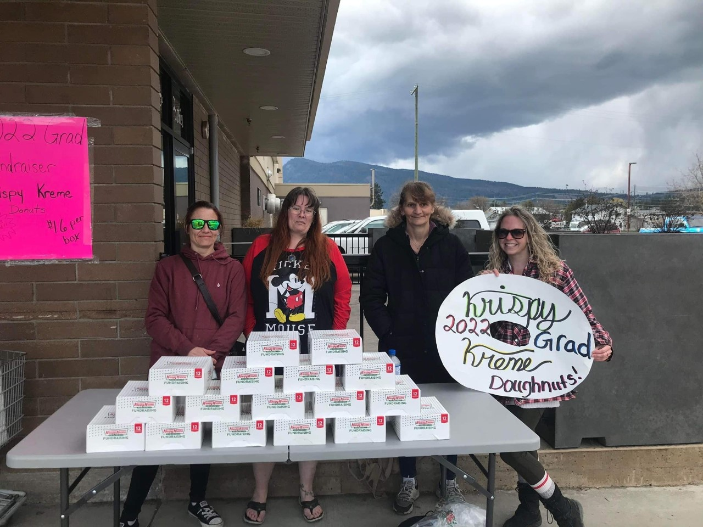
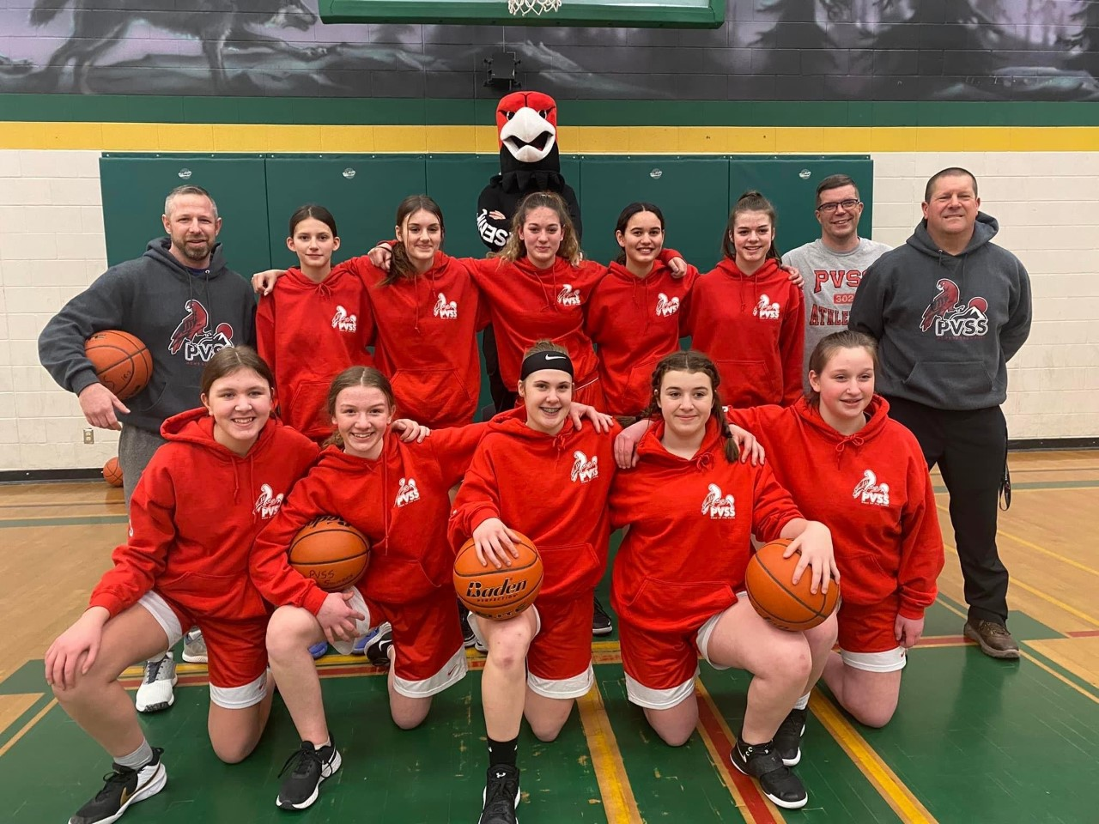
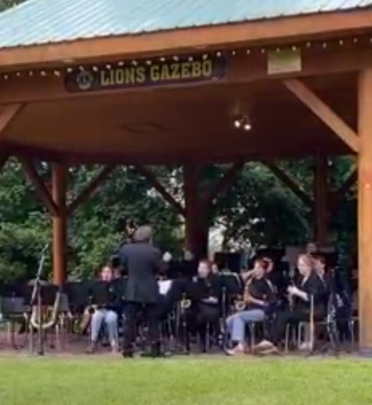
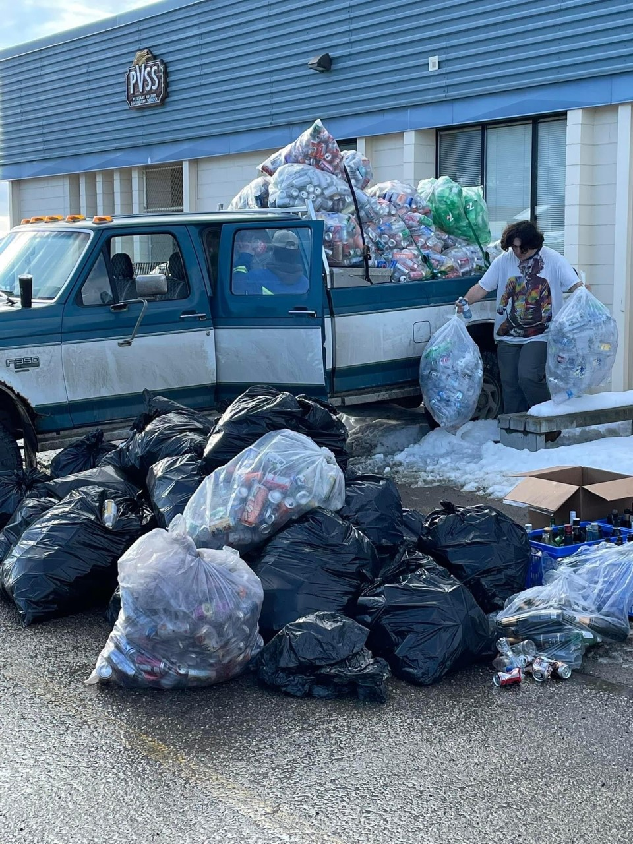
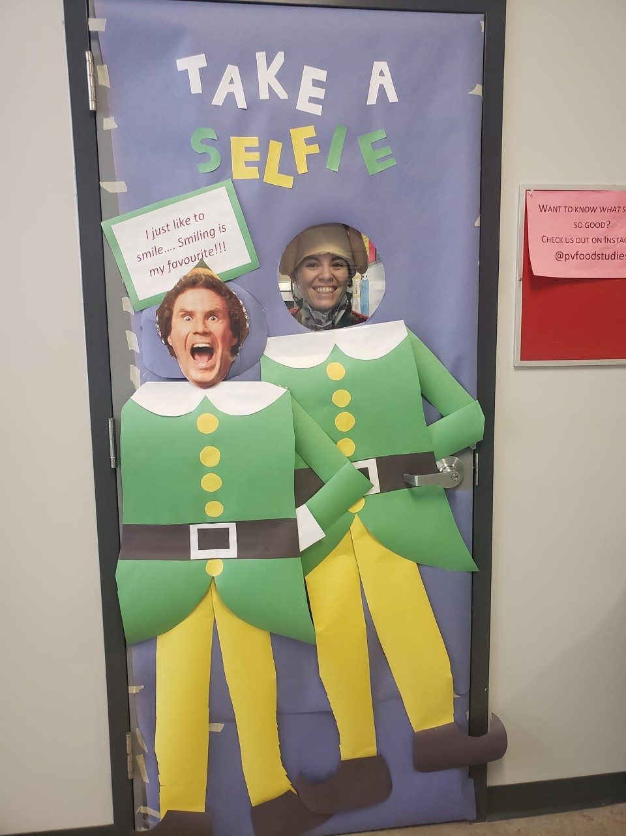

Encourage your kids to Get Involved!
Leadership
School Activities
Field Trips
Athletics

Slide 28
Get Involved!!!
At Lunch/
after school
GSA Club
Art Club
EV Club
Chess Club
Photography Club
Intramurals
Bring your ideas!
School Sports
Fall
Football
Cross country running
Boys Soccer
Volleyball
Winter
Basketball
Curling
Spring
Track and Field
Rugby
Girls Soccer
Golf
Tennis

Slide 29

Questions?

